Slide 1
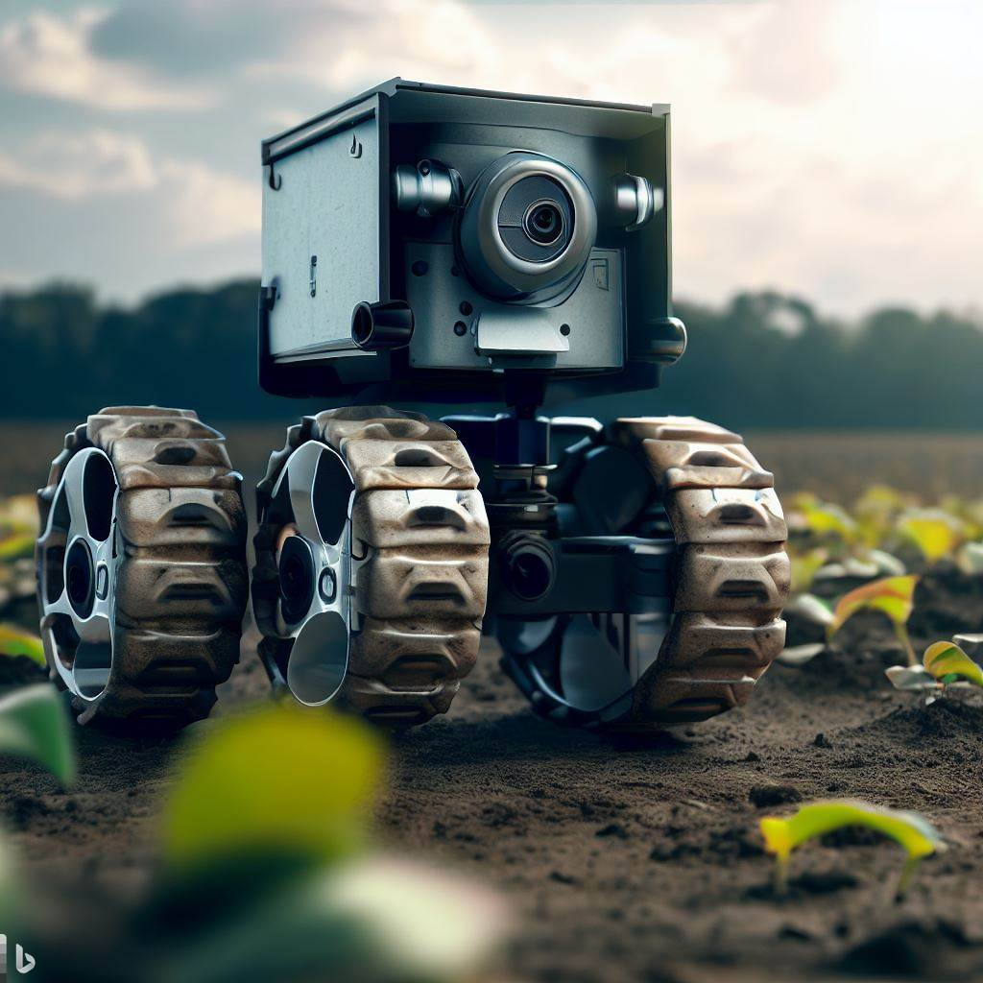
Smart Crop Health Monitoring System An AI-Powered Approach to Enhance Agricultural Productivity and Sustainability
Presented By-
Rohit Singh
Shikhar Pathak
Rishabh Kumar
Satyam Sharma
Priya Asthana

Slide 2
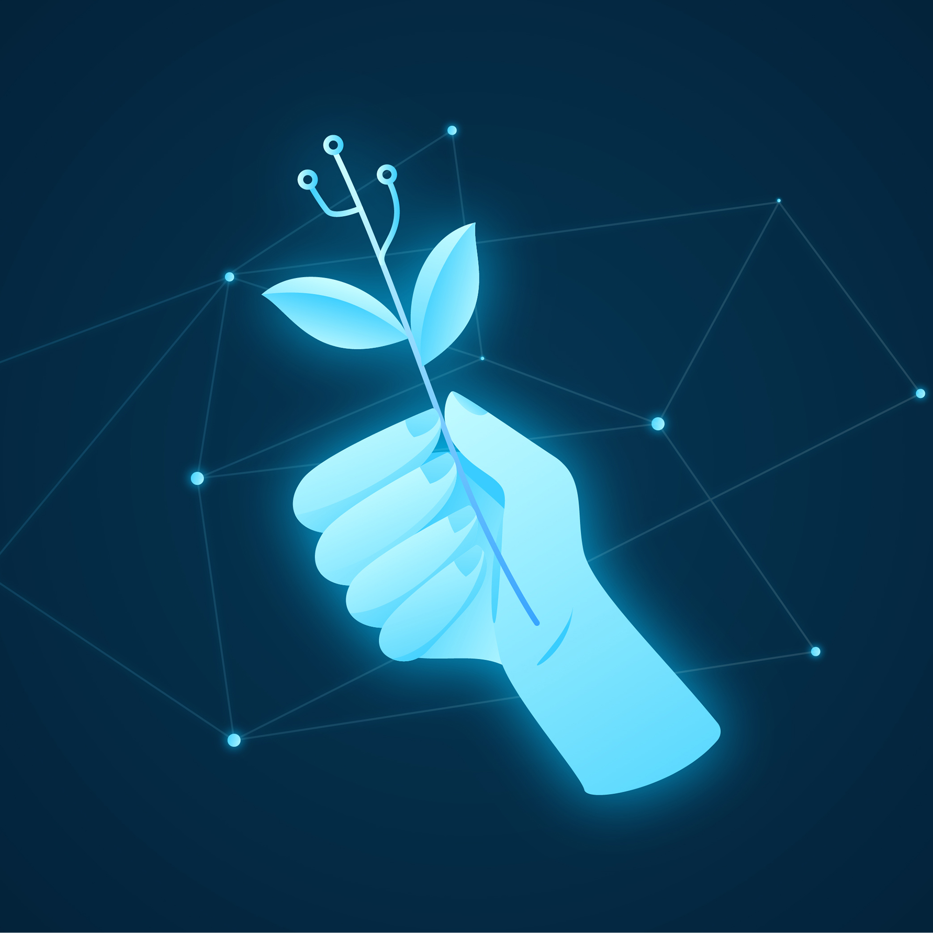
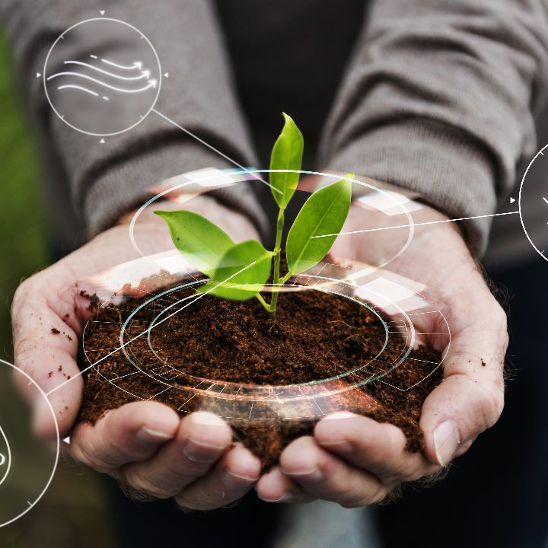

Agenda
Introduction
Proposed Methodology
Results
Conclusion
Future Scope

Slide 3
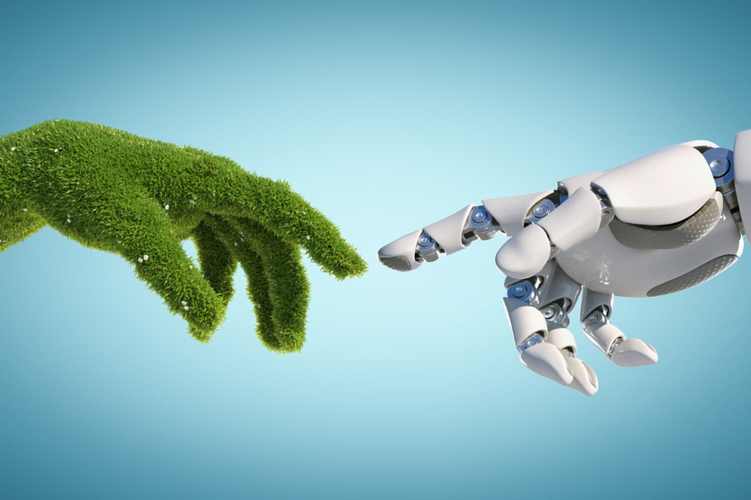
Introduction
This presentation introduces a rover system designed to address the challenges posed by crop diseases in the agricultural sector. With agriculture being a critical sector in India, supporting a significant portion of the population, it is imperative to increase productivity while ensuring food security. Unfortunately, a substantial percentage of potential crop production is lost to pests, diseases, and weeds.
A rover system has been developed to tackle this issue, consisting of two phases. In the first phase, mobility is emphasized, with the rover utilizing an Arduino UNO as its brain and an Android application for control. The rover's design incorporates a six-wheel framework, allowing it to navigate the uneven terrains in agricultural fields. This phase enables farmers to monitor their fields and efficiently move the rover to desired locations.

Slide 4
The second phase focuses on disease detection using advanced technology. The rover is equipped with a Raspberry Pi 4 and a camera module for capturing plant images. These images are sent to Raspberry Pi, which employs a machine learning classifier, specifically Support Vector Machine (SVM), to classify and detect diseases based on plant symptoms. The results are then communicated to the user's mobile device, providing real-time information about the identified diseases.
By combining mobility and disease detection capabilities, this rover system offers farmers a proactive approach to managing crop diseases. Early detection allows for timely preventive measures, significantly reducing crop losses and ensuring higher yields. The system aims to enhance agricultural development in India by promoting sustainable practices, increasing productivity, and addressing the challenges posed by crop diseases.

Slide 5
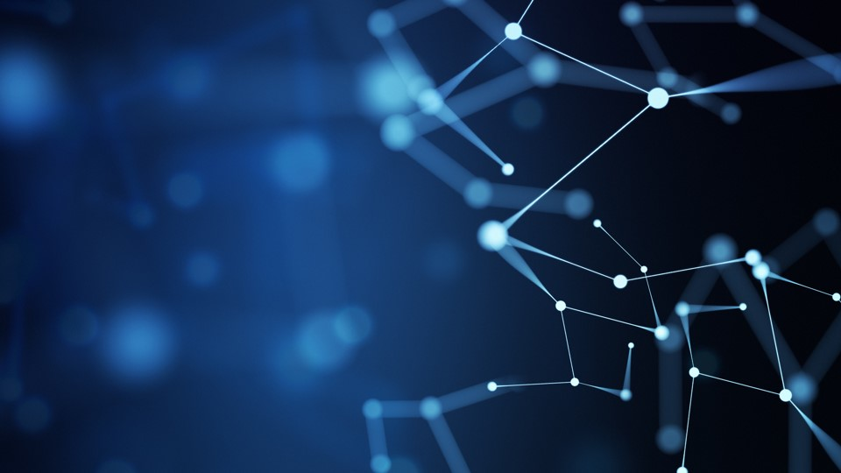
Proposed Methodology
In the first part of this section, we gather the data for five distinct crops: potato, tomato, wheat, maize, and rice. Then, we subcategorize the photos into categories representing plant diseases and healthy plants.
We can now talk about the system's hardware parts. These are the parts that go into creating this system:
a) Raspberry Pi4
b) Arduino UNO
c) Motor driver (L298N)
d) Bluetooth module (HC-05)
e) Camera Module (OV5647)
f) LiFo battery
g) Motors and wheels

Slide 6
We'll go into this system's operation at length in the last part. An Android application connected to the 6-wheeled rover through Bluetooth may be used to simply control it, and the same Android application also provides all of the commands. The rover is controlled by an 11.1-volt Li-Po battery and was programmed in Arduino. Plant diseases are discovered using a Raspberry Pi 4. The procedure is simple: the user approaches the plant with the rover and issues a command using an Android device and an Android app. A machine-learning sketch that can detect diseases is run on the Raspberry Pi via the Arduino board when a button in the Android application is pressed. A What's App message is delivered to the person in question once an illness is discovered. The Raspberry Pi 4 identifies plant illnesses and provides suitable What's App suggestions for treatment. A large dataset containing five crops—potato, tomato, rice, wheat, and corn—as well as the accompanying illnesses, is used to train the model using the SVM technique.

Slide 7
Results
The findings of the experiment indicate that the suggested approach was used to finish the experiment, according to the results.
As the user approaches the plants, a command that checks to see whether any illnesses have infected the plant. If a disease has been found, the What's App message containing the results of the detection is delivered along with potential treatments; if not, it just conveys congratulations to the individual in question.

Slide 8

Conclusion
Various subsystems were integrated to construct a fully functional rover to solve the problem faced by farmers all over the globe. The monitoring of plant health in huge agricultural fields can be time-consuming well as needs human effort. To overcome the certain problem and save human effort which can be diverted for better purposes. This system successfully provides the solution for the affected crops by sending WhatsApp messages to the person, which identifies the disease as well as provides several possible solutions to cure the disease from the present stage. The operation of the rover in the agriculture field is also tested and can tackle pretty rugged surfaces.

Slide 9
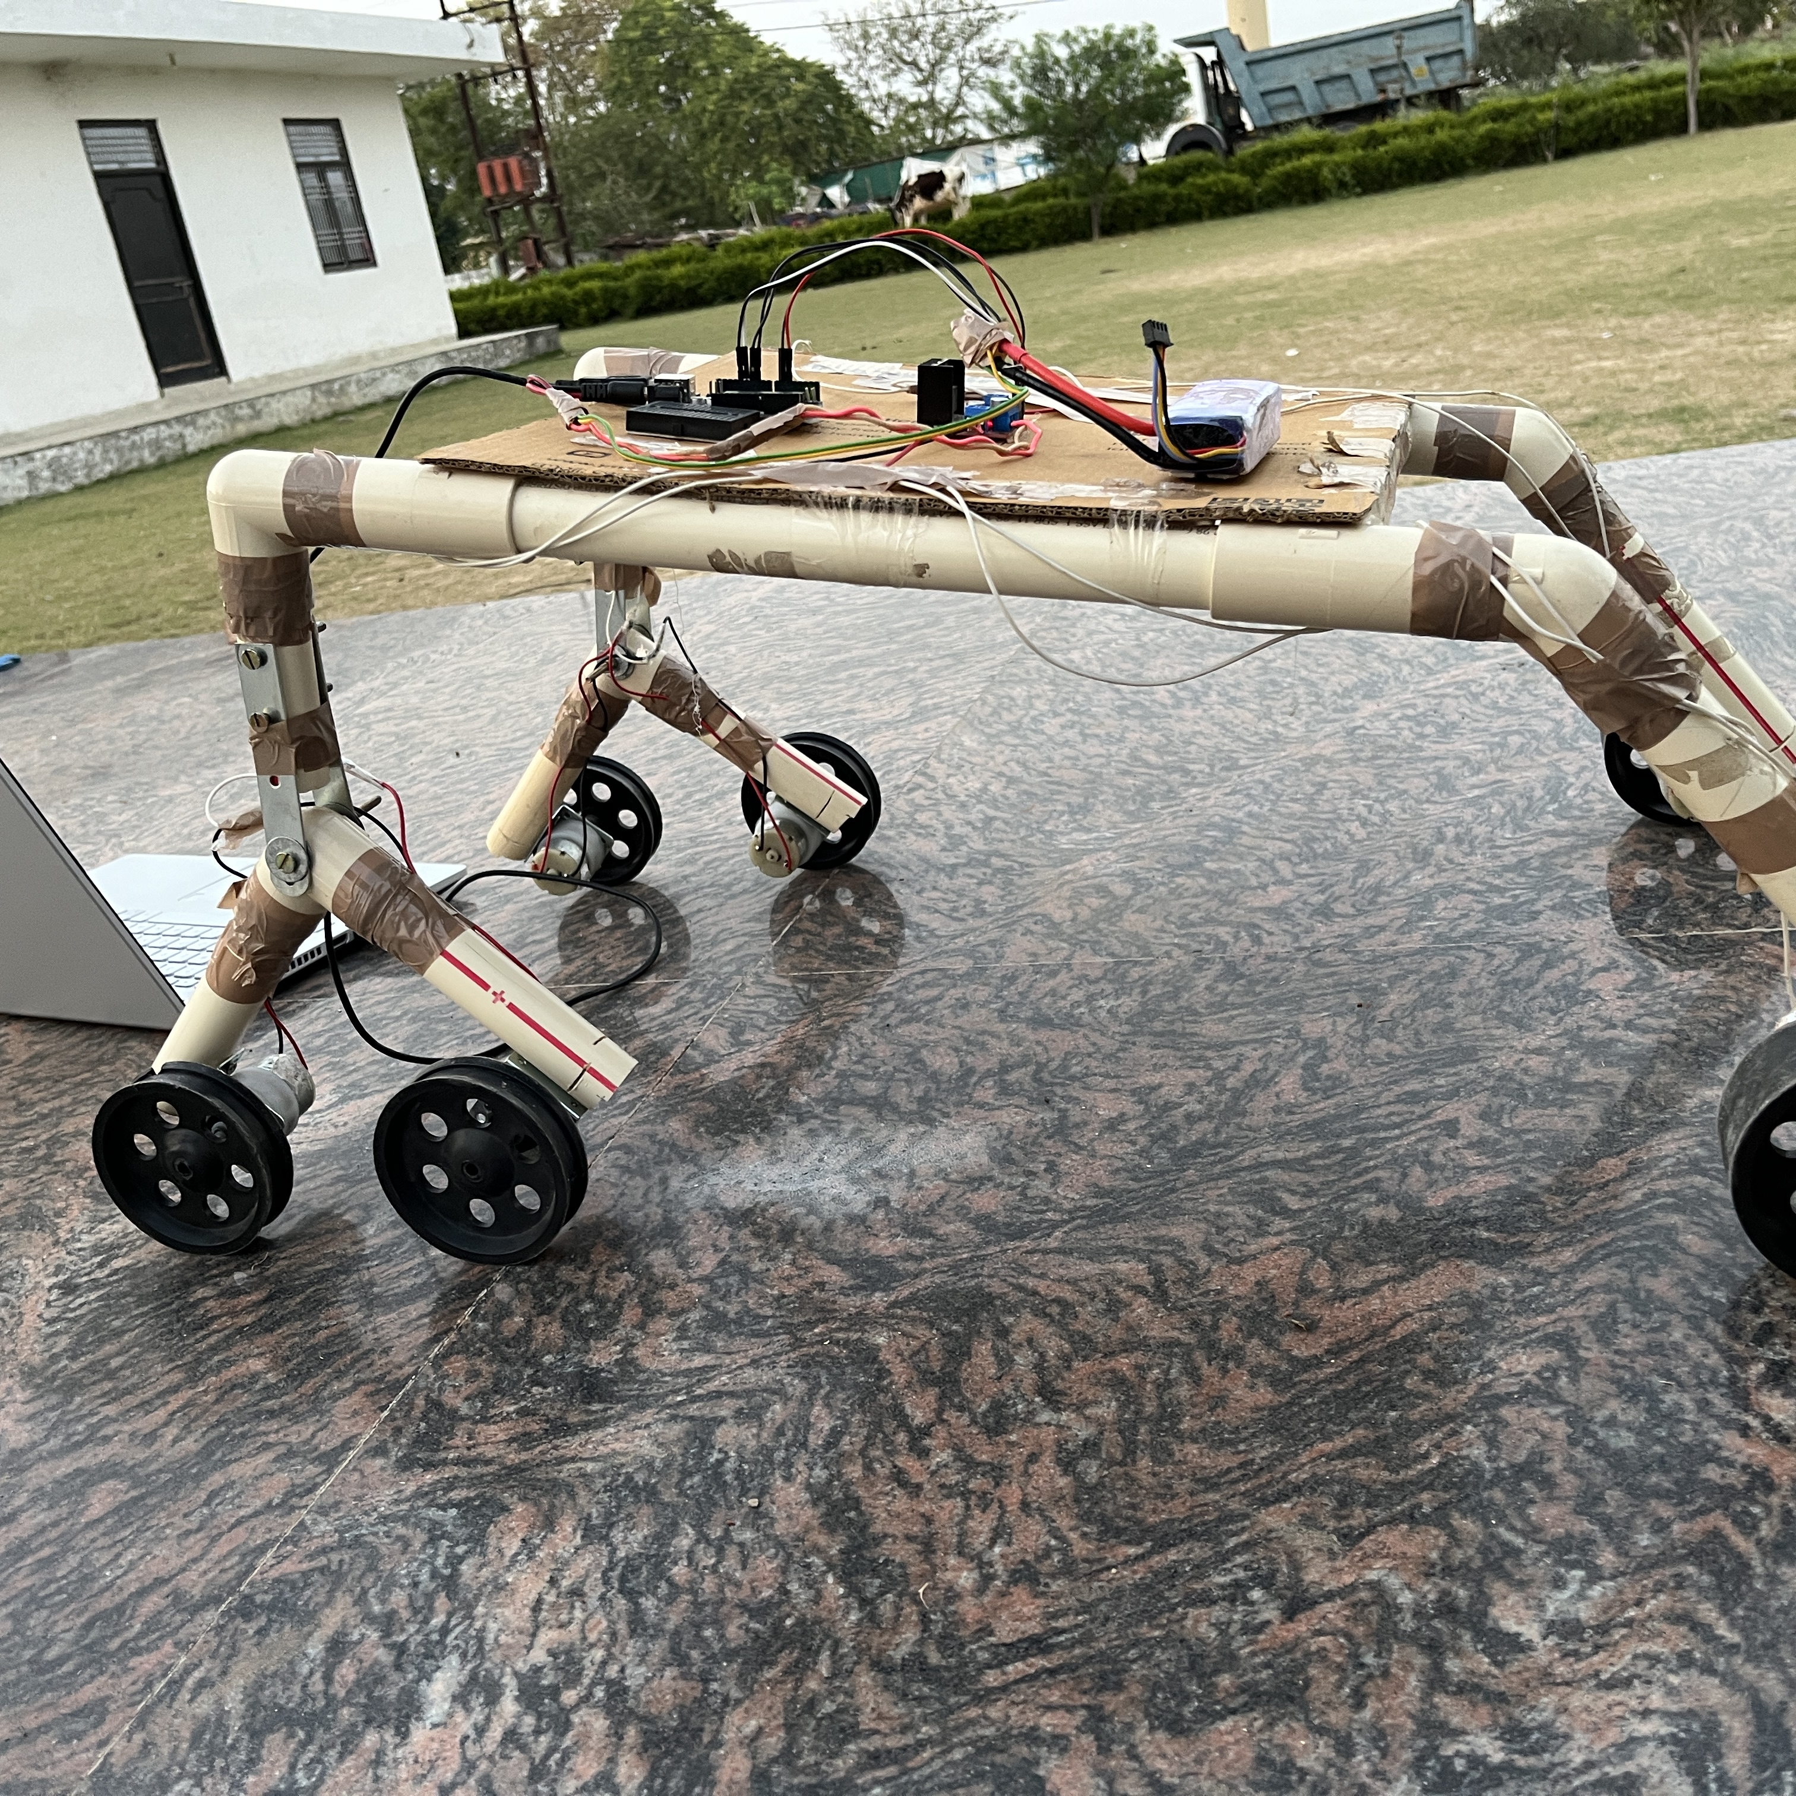
Conclusion
Various subsystems were integrated to construct a fully functional rover to solve the problem faced by farmers all over the globe. The monitoring of plant health in huge agricultural fields can be time-consuming well as needs human effort. To overcome the certain problem and save human effort which can be diverted for better purposes. This system successfully provides the solution for the affected crops by sending WhatsApp messages to the person, which identifies the disease as well as provides several possible solutions to cure the disease from the present stage. The operation of the rover in the agriculture field is also tested and can tackle pretty rugged surfaces.

Slide 10
Timeline
Title
To start a presentation, go to the Slide Show tab, and select From Beginning.
Title
To display Presenter view, in Slide Show view, on the control bar at the bottom left select the three dots, and then Show Presenter View.
Title
During your presentation, the speaker notes are visible on your monitor, but aren't visible to the audience.
Title
Title
If you don’t see the Notes pane or it is completely minimized, click Notes on the task bar across the bottom of the PowerPoint window.
The Notes pane is a box that appears below each slide. Tap it to add notes.

Slide 11
Content 2
Subtitle
subtitle
subtitle
Add text, images, art, and videos.
Add transitions, animations, and motion.
Save to OneDrive, to get to your presentations from your computer, tablet, or phone.
Open the Design Ideas pane for instant slide makeovers.
When we have design ideas, we’ll show them to you right there.
Add text, images, art, and videos.
Add transitions, animations, and motion.
Save to OneDrive, to get to your presentations from your computer, tablet, or phone.
Open the Design Ideas pane for instant slide makeovers.
When we have design ideas, we’ll show them to you right there.
Add text, images, art, and videos.
Add transitions, animations, and motion.
Save to OneDrive, to get to your presentations from your computer, tablet, or phone.
Open the Design Ideas pane for instant slide makeovers.
When we have design ideas, we’ll show them to you right there.

Slide 12
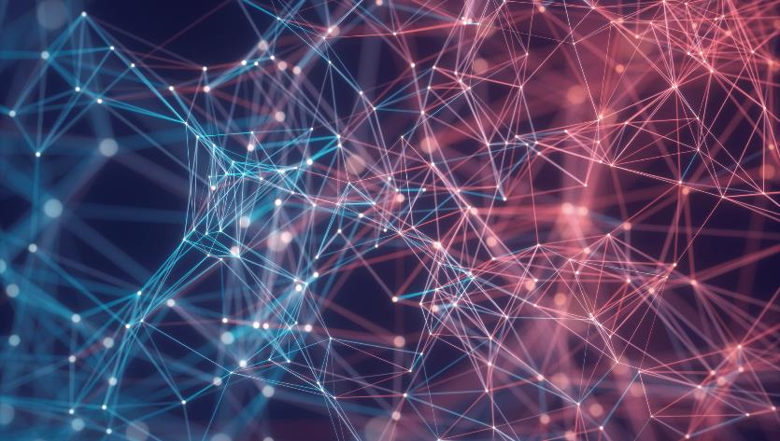

Thank You
Presenter name
Email address
Website address

